Slide 1


Noida Institute of Engineering and Technology, Greater Noida
Python Web Development with Django
Unit: V
Deploying Django Web Application on Cloud
Priya Singh
(Asst. Professor)
CSE Department
Course Details (B. Tech. 5th Sem)

Slide 2

Faculty Introduction
Name | Priya Singh
Qualification | M. Tech. (Computer Engineering)
Designation | Assistant Professor
Department | Computer Science & Engineering
Total Experience | 3 years
NIET Experience | 1 years
Subject Taught | Design & Analysis of Algorithm, Data Structures, Artificial Intelligence, Soft Computing, C Programming, Web Technology, Discrete Mathematics.

Slide 3
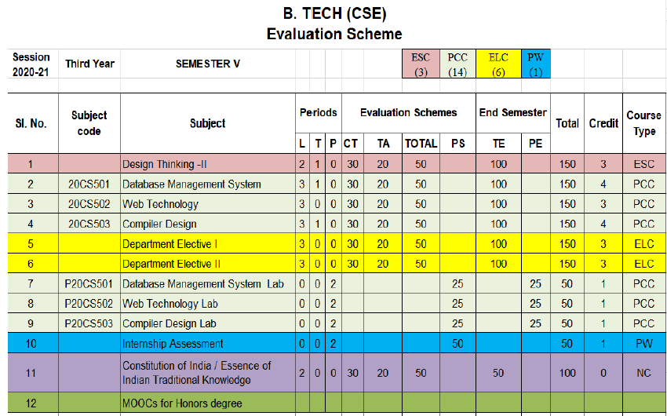
Evaluation Scheme
Python Web development with Django (Elective I)
Design Pattern (Elective II)

Slide 4
Syllabus
UNIT-I: Python libraries for web development
Collections-Container datatypes, Tkinter-GUI applications, Requests-HTTP requests, BeautifulSoup4-web scraping, Scrapy, Zappa, Dash, CherryPy, TurboGears, Flask, Web2Py,
Bottle, Falcon, CubicWeb, Quixote, Pyramid.

Slide 5
Syllabus
UNIT-II: Introduction to Django Framework
Understanding Django environment, Features of Django and Django architecture, MVC &MTV, Urls and Views, Mapping the views to URLs, Django Template, Template inheritance Django Models, Creating model for site, Converting the model into a table, Fields in Models, Integrating Bootstrap into Django, Creating tables, Creating grids, Creating carousels.

Slide 6
Syllabus
UNIT-III: Integrating Accounts & Authentication on Django
Introduction to Django Authentication System, Security Problem & Solution with Django Creating Registration Form using Django, Adding Email Field In Forms, Configuring email settings, Sending emails with Django, Adding Grid Layout On Registration Page, Adding Page Restrictions, Login Functionality Test and Logout.

Slide 7
Syllabus
UNIT-IV: Connecting SQLite with Django
Database Migrations, Fetch Data From Database, Displaying Data On Templates, Adding Condition On Data, Sending data from url to view, Sending data from view to template, Saving objects into database, Sorting objects, Filtering objects, Deleting objects, Difference between session and cookie, Creating sessions and cookies in Django.

Slide 8
Syllabus
UNIT-V: Deploying Django Web Application on Cloud
Creating a functional website in Django, Four Important Pillars to Deploy, Registering on Heroku and GitHub, Push project from Local System to GitHub, Working with Django Heroku
Working with Static Root, Handling WSGI with gunicorn, Setting up Database & adding users

Slide 9
Branch Wise Application
1. Real time web analytics
2. Digital Advertising
3. E-Commerce
4. Publishing
5. Massively Multiplayer Online Games
6. Backend Services and Messaging
7. Project Management & Collaboration
8. Real time Monitoring Services
9.Live Charting and Graphing
10. Group and Private Chat

Slide 10
Course Objective
In this semester, the students will
Study how to shows relationships and interactions between frontend &backend
Study to speed up the development process by providing well-tested, proven development/design paradigms.
Select a specific framework for the development of a given website or webapp.
Analyzing and creating a functional website in Django and deploy Django Web Application on Cloud.

Slide 11
Course Outcomes (COs)
At the end of course, the student will be able to:
CO1 : Apply the knowledge of python programing that are vital in understanding Django application
CO2 : Demonstrate web application framework (Django) to design and implement dynamic website
CO3 : Implementing and analyzing the concept of Integrating Accounts & Authentication on Django
CO4 : Understand the impact of web designing by database connectivity with SQLite
CO5 : Analyzing & Creating a functional website in Django and deploy Django Web Application Cloud

Slide 12
Program Outcomes (POs)
Engineering Graduates will be able to:
PO1 : Engineering Knowledge
PO2 : Problem Analysis
PO3 : Design/Development of solutions
PO4 : Conduct Investigations of complex problems
PO5 : Modern tool usage
PO6 : The engineer and society

Slide 13
Program Outcomes (POs)
Engineering Graduates will be able to:
PO7 : Environment and sustainability
PO8 : Ethics
PO9 : Individual and teamwork
PO10 : Communication
PO11 : Project management and finance
PO12 : Life-long learning

Slide 14

COs - POs Mapping
CO.K | PO1 | PO2 | PO3 | PO4 | PO5 | PO6 | PO7 | PO8 | PO9 | PO10 | PO11 | PO12
CO1 | 2 | 2 | 2 | 3 | 3 | - | - | - | - | - | - | -
CO2 | 3 | 2 | 3 | 2 | 3 | - | - | - | - | - | - | -
CO3 | 3 | 2 | 3 | 2 | 3 | - | - | - | - | - | - | -
CO4 | 3 | 2 | 3 | 2 | 3 | - | - | - | - | - | - | -
CO5 | 3 | 2 | 3 | 3 | 3 | - | - | - | - | - | - | -
AVG | 2.8 | 2.0 | 2.8 | 2.4 | 3.0 | - | - | - | - | - | - | -

Slide 15
Program Specific Outcomes(PSOs)
S. No. | Program Specific Outcomes (PSO) | PSO Description
1 | PSO1 | Understand to shows relationships and interactions between classes or objects of a pattern.
2 | PSO2 | Study to speed up the development process by providing well-tested, proven development
3 | PSO3 | Select a specific design pattern for the solution of a given design problem
4 | PSO4 | Create a catalogue entry for a simple design pattern whose purpose and application is understood.

Slide 16
COs - PSOs Mapping
CO.K | PSO1 | PSO2 | PSO3 | PSO4
CO1 | 3 | - | - | -
CO2 | 3 | 3 | - | -
CO3 | 3 | 3 | - | -
CO4 | 3 | 3 | - | -
CO5 | 3 | 3 | - | -

Slide 17
Program Educational Objectives (PEOs)
Program Educational Objectives (PEOs) | PEOs Description
PEOs | To have an excellent scientific and engineering breadth so as to comprehend, analyze, design and provide sustainable solutions for real-life problems using state-of-the-art technologies.
PEOs | To have a successful career in industries, to pursue higher studies or to support entrepreneurial endeavors and to face the global challenges.
PEOs | To have an effective communication skills, professional attitude, ethical values and a desire to learn specific knowledge in emerging trends, technologies for research, innovation and product development and contribution to society.
PEOs | To have life-long learning for up-skilling and re-skilling for successful professional career as engineer, scientist, entrepreneur and bureaucrat for betterment of society.

Slide 18
Result Analysis(Department Result & Subject Result & Individual result
Name of the faculty | Subject code | Result % of clear passed

Slide 19
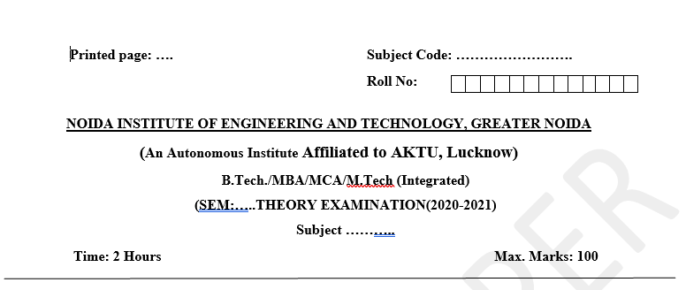
Pattern of Online External Exam Question Paper (100 marks)

Slide 20
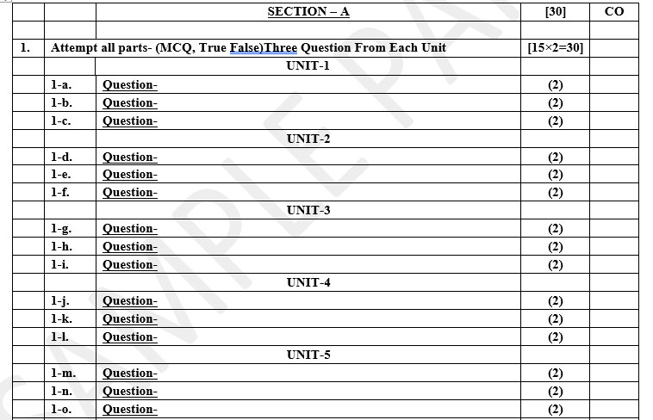
Pattern of Online External Exam Question Paper (100 marks)

Slide 21
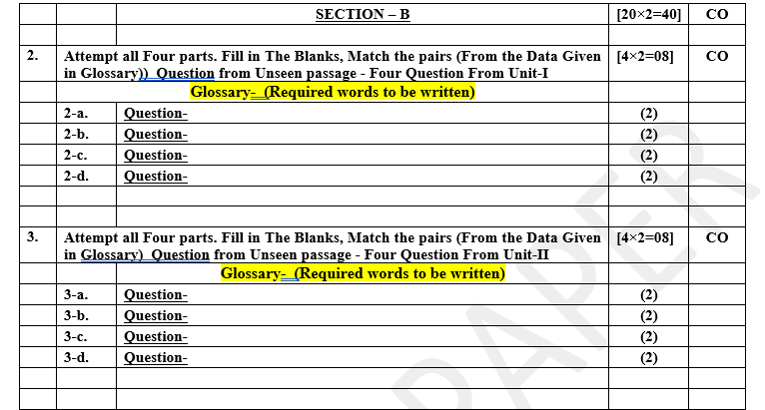
Pattern of Online External Exam Question Paper (100 marks)

Slide 22
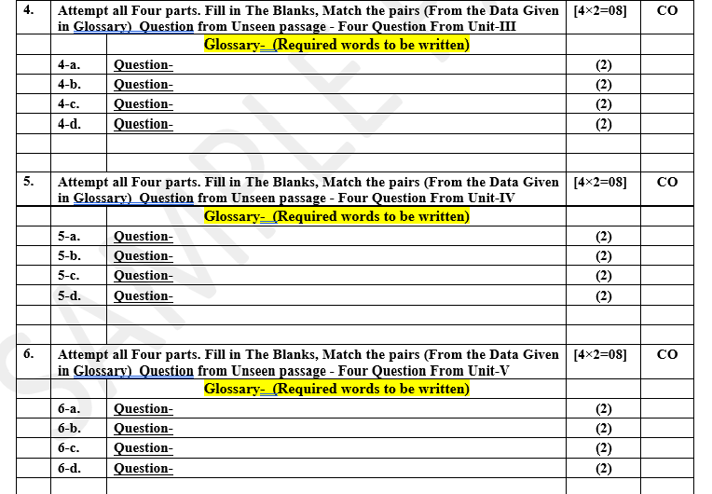
Pattern of Online External Exam Question Paper (100 marks)

Slide 23
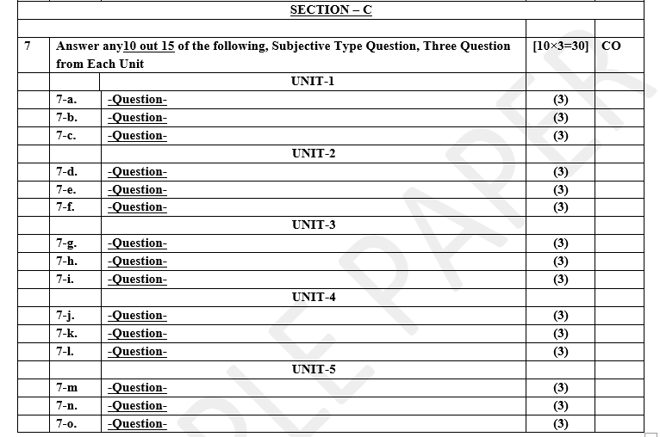
Pattern of Online External Exam Question Paper (100 marks)

Slide 24
Prerequisite / Recap
Student should have knowledge of HTML , CSS and JavaScript .
Students should have good knowledge of Python Programming and Python coding experience.
knowledge of Computer and basic skill.
Good problem solving Skill .

Slide 25
Brief Introduction about the Subject with videos
YouTube /other Video Links
https://youtu.be/eoPsX7MKfe8?list=PLIdgECt554OVFKXRpo_kuI0XpUQKk0ycO
https://youtu.be/tA42nHmmEKw?list=PLh2mXjKcTPSACrQxPM2_1Ojus5HX88ht7
https://youtu.be/8ndsDXohLMQ?list=PLDsnL5pk7-N_9oy2RN4A65Z-PEnvtc7rf
https://youtu.be/QXeEoD0pB3E?list=PLsyeobzWxl7poL9JTVyndKe62ieoN-MZ3
https://youtu.be/9MmC_uGjBsM?list=PL3pGy4HtqwD02GVgM96-V0sq4_DSinqvf

Slide 26
Unit V Content
Creating a functional website in Django.
Four Important Pillars to Deploy.
Registering on Heroku and GitHub, Push project from Local System to GitHub.
Working with Django Heroku.
Working with Static Root.
Handling WSGI with gunicorn.
Setting up Database & adding users.

Slide 27
Unit V Objective
In Unit V, the students will be able to find
Define Four Important Pillars to Deploy.
How to Registering on Heroku and GitHub .
Working with Django Heroku.
What is WSGI and relationship with gunicorn.
Setting up Database & adding users.

Slide 28
Topic Objective
Topic : Collection— Creating a functional website in Django
In this topic, the students will gain , The idea of Having a website helps grow an online presence, whether that be your personal blog or business, by connecting you with a broader audience. A website can also become a platform for sharing your opinions and skills, creating opportunities for personal or work-related projects.

Slide 29
Creating a functional website in Django
Having a website helps grow an online presence, whether that be your personal blog or business, by connecting you with a broader audience. A website can also become a platform for sharing your opinions and skills, creating opportunities for personal or work-related projects.
This lecture will help you turn your website idea into a fully-functional website – pick a suitable platform, get a web hosting plan, and choose a memorable domain name. We’ll also give you tips on how to optimize it.
Before creating your first website, you need to understand these three essential elements – what’s a website building platform, web hosting, and a domain name.

Slide 30
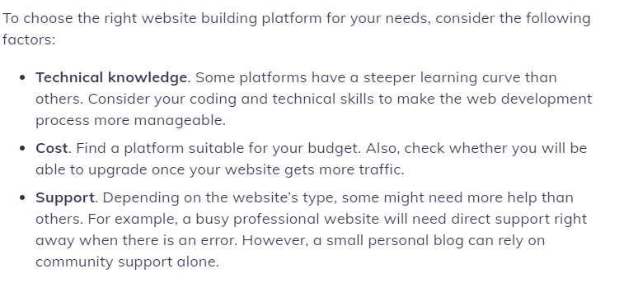
Creating a functional website in Django

Slide 31
Four Important Pillars to Deploy
Pillar One: Technology
Front and backend development processes can drastically affect the overall performance of your site. Visitors are mostly affected by frontend site performance, e.g. the way that your site performs when a user goes to the homepage or clicks on an internal link. It’s the most visible indicator of site performance, because it’s pretty obvious if a user is staring at a blank screen for 5-10 seconds, that a site isn’t performing at its peak.
When you change a piece of tech, add a new feature, or even update an existing plugin, you should always test your performance to see if it was negatively impacted. That way you can continue to upgrade your tech, while also improving overall performance.

Slide 32
Four Important Pillars to Deploy
Where you host your site also has a huge impact on frontend and backend performance. Check what kind of performance-enhancing features your host might offer, like caching or a global CDN. Having these kinds of features with your host can really take the burden off of your internal development team.
While a lot of updates add new functions or improve the performance of their particular piece of software, we’re all familiar with how one seemingly miniscule update can bring even the most immaculately maintained site to its knees. This, of course, will have terrible effects on your site performance. As you continue to update individual pieces of your site, you need to remember to maintain the whole, or find a partner to perform regular site maintenance.

Slide 33
Four Important Pillars to Deploy
Pillar Two: UX and Usability
The basic goal of UX work is to reduce friction, i.e. to make the experience feel as seamless and smooth as possible. Believe it or not, friction is actually a measurable datapoint.
There are plenty of frameworks that exist to measure friction. One of the easiest ways is to observe users interacting with your site. Perform an evaluation on your site to see where exactly users are experiencing friction, and where you can improve. Some of the most common areas of friction are:

Slide 34
Four Important Pillars to Deploy
Page speed is a huge indicator for how happy a user will be on your site. After all, if a page never loads, how can you ever see if it actually converts?
Constantly getting sold and marketed to has made users numb to the sales-centric copywriting of days past.
Now users just want the information they’re looking for explained clearly and concisely. Try combing through your site and look for ways to improve CTAs, menus, and headers. You’d be surprised at the impact a seemingly tiny change can have.

Slide 35
Four Important Pillars to Deploy
Pillar Three: Conversions
Conversion can mean a lot of different things. Is your site converting visitors into leads? Leads into customers? Are users converting from one page to another? Filling out a form? There are plenty of ways to define conversions. Put plainly, if your site isn’t converting, is it really performing the way it should?
That wasn’t a rhetorical question. Of course it’s not! Every pillar of performance is connected, and if users aren’t converting, your technology or user experience is probably lacking. So what can you do? Make some changes! Of course, those changes don’t mean anything if you’re not…
(Always Be Testing)

Slide 36
Four Important Pillars to Deploy
Pillar Four: Retention
Which costs more? Attracting a new customer, or reselling to an existing one? Not surprisingly, keeping existing customers happy is a lot less expensive than attracting new ones. A large part of keeping existing customers happy depends on your platform and how it performs, not just when the initial sale gets made, but as customers continue to interact with your business.
Retention and churn are often seen as an issue of platform or service, but in reality churn can be attributed to something much more simple: attracting the wrong customer. When you spend your time creating a great user experience, speedy website, testing changes, and collecting data, you attract the right customer to your product. This means less churn and more long-term customer success.

Slide 37
Django Middleware
In Django, middleware is a lightweight plugin that processes during request and response execution. Middleware is used to perform a function in the application. The functions can be a security, session, csrf protection, authentication etc.
Django provides various built-in middleware and also allows us to write our own middleware. See, settings.py file of Django project that contains various middleware, that is used to provides functionalities to the application. For example, Security Middleware is used to maintain the security of the application.

Slide 38
Custom middleware in Django
Custom middleware in Django is created either as a function style that takes a get_response callable or a class-based style whose call method is used to process requests and responses. It is created inside a file middleware.py. A middleware is activated by adding it to the MIDDLEWARE list in Django settings.
Very often you would have used request.user inside the view. Django wants user attribute to be set on request before any view executes. Django takes a middleware approach to accomplish this. So Django provides an AuthenticationMiddleware which can modify the request object.

Slide 39
Version Control System
Version control systems are a category of software tools that helps in recording changes made to files by keeping a track of modifications done in the code.
A version control system is a kind of software that helps the developer team to efficiently communicate and manage(track) all the changes that have been made to the source code along with the information like who made and what changes have been made.

Slide 40
WSGI and uWSGI
WSGI: A Python spec that defines a standard interface for communication between an application or framework and an application/web server. This was created in order to simplify and standardize communication between these components for consistency and interchangeability. This basically defines an API interface that can be used over other protocols.
uWSGI: An application server container that aims to provide a full stack for developing and deploying web applications and services. The main component is an application server that can handle apps of different languages. It communicates with the application using the methods defined by the WSGI spec, and with other web servers over a variety of other protocols. This is the piece that translates requests from a conventional web server into a format that the application can process.

Slide 41
Registering on Heroku and GitHub
HERUKO
Heroku is one of the longest running and popular cloud-based PaaS services. It originally supported only Ruby apps, but now can be used to host apps from many programming environments, including Django.
Why to chose Heroku:
Heroku has a free tier that is really free.
As a PaaS, Heroku takes care of a lot of the web infrastructure for us. This makes it much easier to get started, because you don't worry about servers, load balancers, reverse proxies, or any of the other web infrastructure that Heroku provides for us under the hood.
Some of the companies using Heroku are:
StackShare, Accenture, Product Hunt, Stitch Fix, MAK IT, Heroku, Pier, ReadMe.io.

Slide 42
Registering on Heroku and GitHub
So, what is Heroku and how does it work?
Heroku runs Django websites within one or more "Dynos", which are isolated, virtualized Unix containers that provide the environment required to run an application. The dynos are completely isolated and have an ephemeral file system (a short-lived file system that is cleaned/emptied every time the dyno restarts).
The only thing that dynos share by default are application configuration variables. Heroku internally uses a load balancer to distribute web traffic to all "web" dynos.
Since nothing is shared between them, Heroku can scale an app horizontally by adding more dynos.
Because the file system is ephemeral you can't install services required by your application directly. Instead Heroku web applications use backing services provided as independent "add-ons" by Heroku or 3rd parties.

Slide 43
Registering on Heroku and GitHub
In order to execute your application Heroku needs to be able to set up the appropriate environment and dependencies, and also understand how it is launched. For Django apps we provide this information in a number of text files:
runtime.txt: the programming language and version to use.
requirements.txt: the Python component dependencies, including Django.
Procfile: A list of processes to be executed to start the web application. For Django this will usually be the Gunicorn web application server (with a wsgi script).
wsgi.py: WSGI configuration to call our Django application in the Heroku environment.
In order to get our application to work on Heroku we'll need to put our Django web application into a git repository, add the files above, integrate with a database add-on, and make changes to properly handle static files.
Once we've done all that we can set up a Heroku account, get the Heroku client, and use it to install our website.
11/25/2022
Priya Singh Python web development with Django Unit V
43

Slide 44
Registering on Heroku and GitHub
Why use Heroku when AWS is present?
Heroku runs on Amazon Web Services (AWS).
AWS is an Infrastructure as a Service(IaaS) provider, meaning they are responsible for managing large, shared data centers. These data centers are what we call “the cloud”. Companies like AWS, Azure, and Google have all created IaaS so that developers can pay to host their applications in these data centers instead of building servers themselves.
This is a great trade-off but due to the nature of their business, IaaS providers are more concerned with running the data centers than the developer’s experience working with them. This means there is a high level of knowledge of AWS is required to keep your apps running, especially at scale.

Slide 45
Registering on Heroku and GitHub
Heroku, on the other hand, is a Platform as a Service that sits on top of AWS to provide an experience that is specifically designed to make developers lives easier. For example, in order to keep an application running at scale on Heroku, it only takes knowledge of a few commands on the Heroku CLI and Dashboard.
These commands can easily be found in Heroku’s documentation. Again, Heroku was built by developers for developers. The experience is easy to navigate, developers know exactly what they need to do when they log in, and they know exactly how their application is running every second the platform.

Slide 46
Registering on Heroku and GitHub
What is GitHub And How To Use It?
GitHub is an increasingly popular programming resource used for code sharing. It's a social networking site for programmers that many companies and organizations use to facilitate project management and collaboration.
According to statistics collected in October 2020, it is the most prominent source code host, with over 60 million new repositories created in 2020 and boasting over 56 million total developers.
GitHub is a Git repository hosting service that provides a web-based graphical interface. It is the world’s largest coding community. C language is mainly used in Git.

Slide 47
Registering on Heroku and GitHub
GitHub helps every team member work together on a project from any location while facilitating collaboration. You can also review previous versions created at an earlier point in time.
Features:
1. Easy Project Management
GitHub is a place where project managers and developers come together to coordinate, track, and update their work so that projects are transparent and stay on schedule.
2. Increased Safety With Packages
Packages can be published privately, within the team, or publicly to the open-source community. The packages can be used or reused by downloading them from GitHub.
3. Effective Team Management
GitHub helps all the team members stay on the same page and organized. Moderation tools like Issue and Pull Request Locking help the team to focus on the code.

Slide 48
Commands that helps to push your files to GitHub repository
git init
git add
git commit -m "Add existing project files to Git“
git remote add origin https://github.com/cameronmcnz/example-website.git
git push -u -f origin master

Slide 49
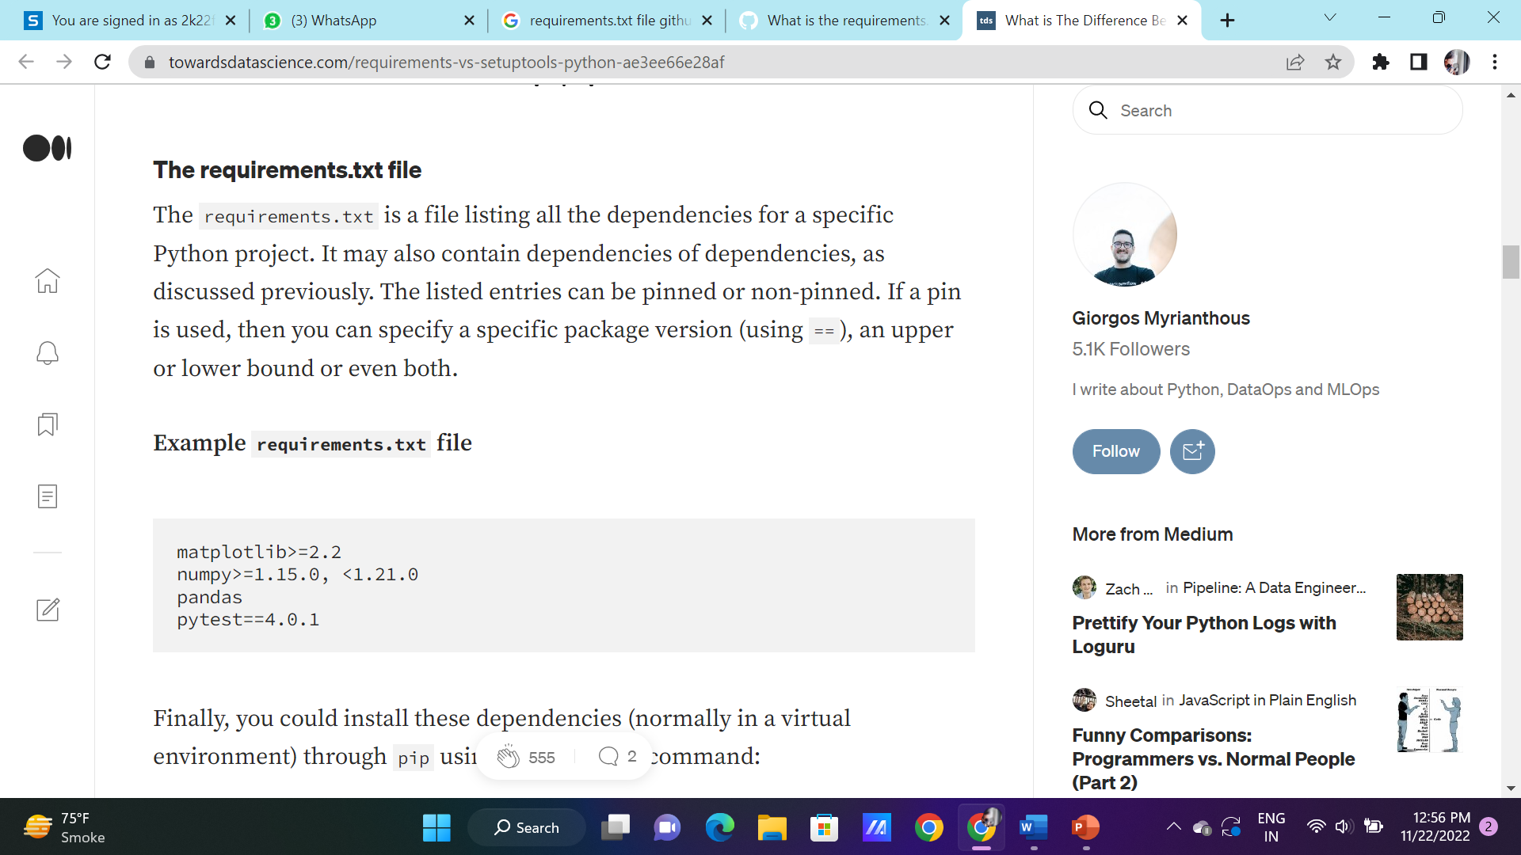
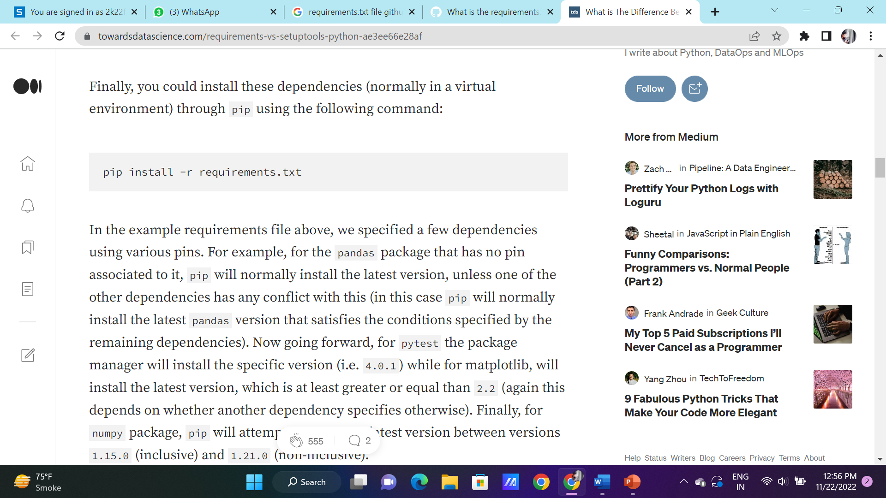

Slide 50
.gitignore File
A gitignore file specifies intentionally untracked files that Git should ignore. Files already tracked by Git are not affected; see the NOTES below for details.
Each line in a gitignore file specifies a pattern. When deciding whether to ignore a path, Git normally checks gitignore patterns from multiple sources, with the following order of precedence, from highest to lowest (within one level of precedence, the last matching pattern decides the outcome):
Patterns read from the command line for those commands that support them.
Patterns read from a .gitignore file in the same directory as the path, or in any parent directory (up to the top-level of the working tree), with patterns in the higher level files being overridden by those in lower level files down to the directory containing the file. These patterns match relative to the location of the .gitignore file. A project normally includes such .gitignore files in its repository, containing patterns for files generated as part of the project build.
Patterns read from $GIT_DIR/info/exclude.
Patterns read from the file specified by the configuration variable core.excludesFile.

Slide 51
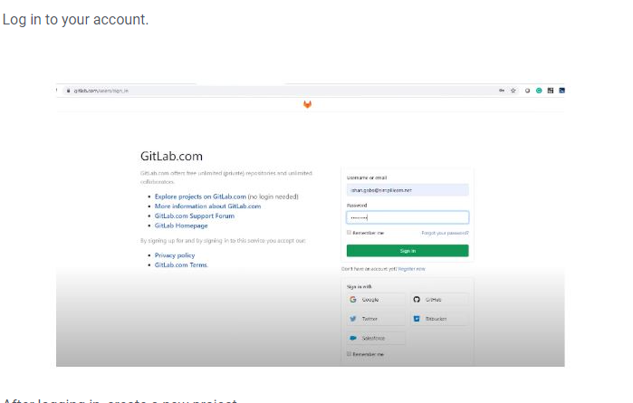
Push project from Local System to GitHub

Slide 52
Working with Django Heroku
How to Deploy Django application on Heroku ?
Django is an MVT web framework used to build web applications. It is robust, simple, and helps web developers to write clean, efficient, and powerful code. In this lecture, we will learn how to deploy a Django project on Heroku in simple steps. For this, a Django project should be ready.
Heroku account
1. Install your Heroku toolbelt which you can find here: https://toolbelt.heroku.com
2. Authenticate your Heroku account either running the below command in cmd or gitbash
$heroku login

Slide 53
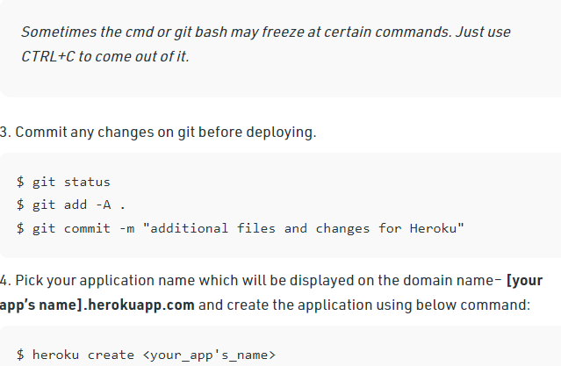
Working with Django Heroku

Slide 54
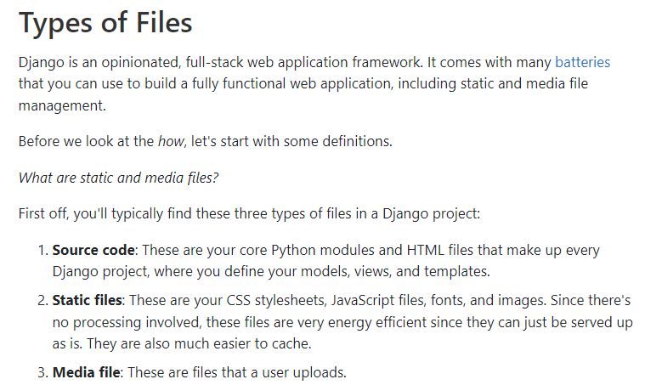
Working with Static Root

Slide 55
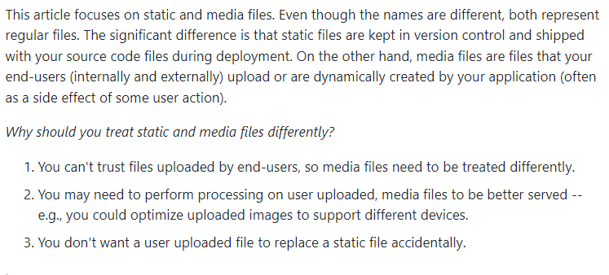
Working with Static Root

Slide 56
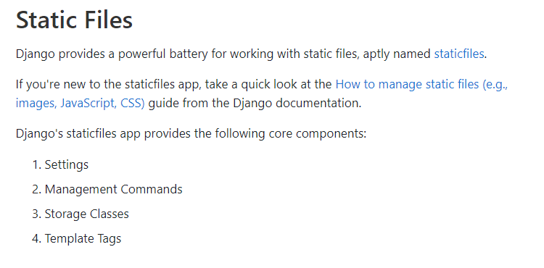
Working with Static Root

Slide 57
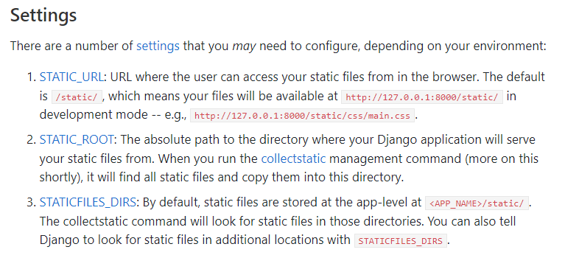
Working with Static Root

Slide 58
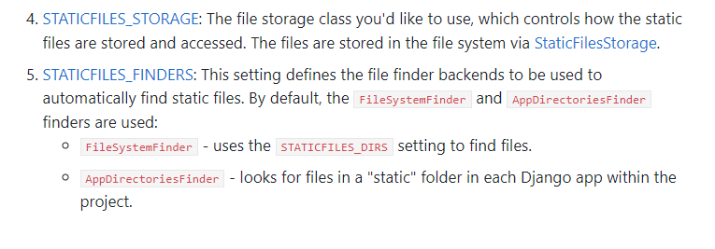
Working with Static Root

Slide 59
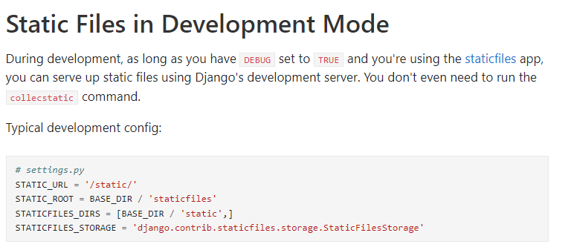
Working with Static Root

Slide 60
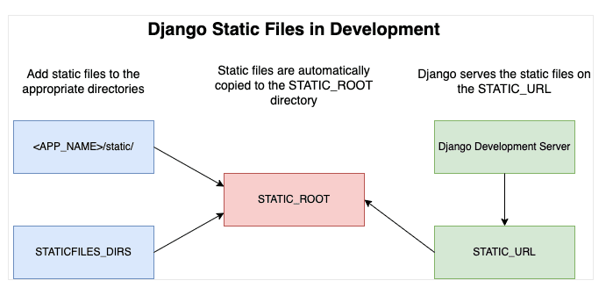
Working with Static Root

Slide 61
Handling WSGI with gunicorn
Gunicorn - WSGI server:-
Gunicorn ‘Green Unicorn’ is a Python WSGI HTTP Server for UNIX. It’s a pre-fork worker model ported from Ruby’s Unicorn project. The Gunicorn server is broadly compatible with various web frameworks, simply implemented, light on server resources, and fairly speedy.
Features
Natively supports WSGI, Django, and Paster
Automatic worker process management
Simple Python configuration
Multiple worker configurations
Various server hooks for extensibility
Compatible with Python 3.x >= 3.5

Slide 62
Handling WSGI with gunicorn
Gunicorn is a stand-alone WSGI web application server which offers a lot of functionality. It natively supports various frameworks with its adapters, making it an extremely easy to use drop-in replacement for many development servers that are used during development.
Technically, the way Gunicorn works is very similar to the successful Unicorn web server for Ruby applications. They both use what’s referred to as the pre-fork model. This, in essence, tasks the central [Gunicorn] master process to handle the management of workers, creation of sockets and bindings, etc.
Nginx is a very high performant web server / (reverse)-proxy. It has reached its current popularity due to being light weight, relatively easy to work with, and easy to extend (with add-ons / plug-ins).

Slide 63
Setting up Database & adding users
There are several ways to extend the the default Django User model. Perhaps one of the most common way (and also less intrusive) is to extend the User model using a one-to-one link.
This strategy is also known as User Profile. One of the challenges of this particular strategy, if you are using Django Admin, is how to display the profile data in the User edit page. And that’s what this tutorial is about.
Then a very important thing, we need to override the get_inline_instances method, so to display the inlines only in the edit form. Otherwise we might get some problems because of how the Signals work. Remember that the Signal is responsible for creating the Profile instance.

Slide 64
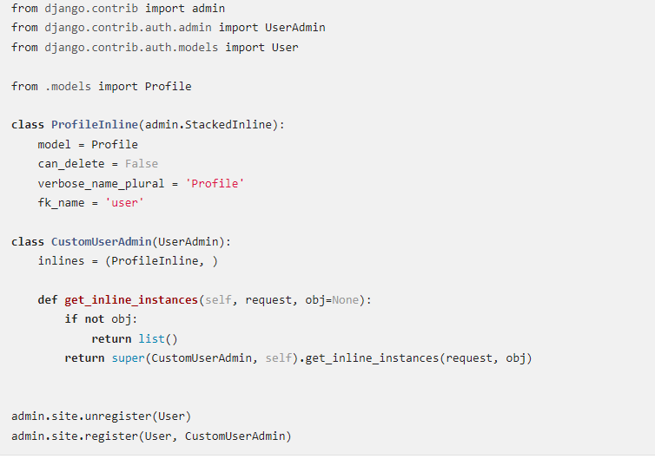
Setting up Database & adding users

Slide 65
Daily Quiz
Discuss Four Important Pillars to website.
What is the role of frameworks in python.
Discuss any three frameworks.
What is Heroku, explain its architecture.
Discuss WSGI .
Explain gunicorn .
Discuss the role of Git .
Discuss the architecture of Git.
Discuss about the Request Http methods in Python.
Discuss about Flask application.

Slide 66
Weekly Assignment
What are the most important pillar of website .
What are the disadvantages of Django?
What are the different data types used in Django.
What are the salient features of Django.
What are some of the technical features that Django includes

Slide 67
Topic Link ( YouTube & NPTEL Video Links)
YouTube /other Video Links
https://youtu.be/eoPsX7MKfe8?list=PLIdgECt554OVFKXRpo_kuI0XpUQKk0ycO
https://youtu.be/tA42nHmmEKw?list=PLh2mXjKcTPSACrQxPM2_1Ojus5HX88ht7
https://youtu.be/8ndsDXohLMQ?list=PLDsnL5pk7-N_9oy2RN4A65Z-PEnvtc7rf
https://youtu.be/QXeEoD0pB3E?list=PLsyeobzWxl7poL9JTVyndKe62ieoN-MZ3
https://youtu.be/9MmC_uGjBsM?list=PL3pGy4HtqwD02GVgM96-V0sq4_DSinqvf

Slide 68
MCQ s
1. What is a Django App? ADjango app is an extended package with base package is Django B. Django app is a python package with its own components. C. Both 1 & 2 Option D. All of the above | 2. Django was introduced by A. Adrian Holovaty B. Bill Gates C. Rasmus Lerdorf D. Tim Berners-Lee
3. What are Migrations in Django A. They are files saved in migrations directory. B. They are created when you run make migrations command. C. Migrations are files where Django stores changes to your models. D. All of the above
4. Which architectural pattern does django follow APHP B. MVT C. HTML D. None of the above

Slide 69
MCQ s
which of these is not a valid backend for caching in django
A. Django.core.cache.backends.sys.memory
B. django.core.cache.backends.db.DatabaseCache
C. django.core.cache.backends.locmem.LocMemCache
D. None of the above
5. Which architectural pattern does django follow
A.PHP
B. MVT
C. HTML
D. None of the above

Slide 70
MCQ s
6. Python is a : Development environment Set of editing tools Programming Language | Python is Case Sensitive when dealing with Identifiers? Yes No Sometimes Only None Of the Above
What is the OUTPUT of the following Statement? print 0xA + 0xB + 0xC : 0xA0xB0xC 33 ABC 000XXXABC | What is the OUTPUT when the following Statement is executed? “abc”+”xyz” abc abcxyz abcz abcxy
what is the type of a? a={1,2:3} list set dict syntax error

Slide 71
Glossary Questions
Top 10 design pattern interview questions
Explain Django Architecture?
Explain the Django project directory structure?
What are models in Django?
What are templates in Django or Django template language?
What are views in Django?
What is Django ORM?
What is Django Rest Framework(DRF)?
What is the difference between a project and an app in Django?
What are different model inheritance styles in the Django?
What are Django Signals?

Slide 72
Expected Questions for University Exam
Top 10 design pattern interview questions
Explain Django Architecture?
Explain the Django project directory structure?
What are models in Django?
What are templates in Django or Django template language?
What are views in Django?
What is Django ORM?
What is Django Rest Framework(DRF)?
What is the difference between a project and an app in Django?
What are different model inheritance styles in the Django?
What are Django Signals?

Slide 73
Summary
Till Now we understand The idea of Having a website helps grow an online presence, whether that be your personal blog or business, by connecting you with a broader audience. A website can also become a platform for sharing your opinions and skills, creating opportunities for personal or work-related projects.
Four Important Pillars to Deploy i.e Technology, UX and usability ,conversation and Retention. Django is an MVT web framework used to build web aplications. It is robust, simple, and helps web developers to write clean, efficient, and powerful code. In this lecture, we will learn how to deploy a Django project on Heroku in simple steps. GitHub is an increasingly popular programming resource used for code sharing. It's a social networking site for programmers that many companies and organizations use to facilitate project management and collaboration.

Slide 74
References
(1) Tom Aratyn, “Building Django 2.0 Web Applications: Create enterprise-grade, scalable Python web applications easily with Django 2.0”, 2nd Edition 2018, Packt Publishing.
(2) Nigel George, “Build a website with Django”, 1st Edition 2019, GNW Independent Publishing Edition.
(3) Ray Yao,” Django in 8 Hours: For Beginners, Learn Coding Fast!, 2nd Edition 2020, Independently published Edition.
(4) Harry Percival, “Test-Driven Development with Python: Obey the Testing Goat: Using Django, Selenium, and JavaScript”, 2nd Edition 2019, Kindle Edition.

Slide 75
THANK YOU

